Slide 1
Food Security, Biosecurity and National Security in the Melanesian Arc –
THE FIJI CONTEXT
PRESENTATION BY HIS EXCELLENCY HIGH COMMISSIONER YOGESH PUNJA
HIGH COMMISSIONER OF THE REPUBLIC OF FIJI

Slide 2
OVERVIEW
Introduction
National Security
Biosecurity
Food Security
Climate Change
Conclusion

Slide 3
introduction
Fiji is a country of over 300 islands, 1/3 of which are inhabited.
Population of close to 900,000
Total land area approx. 18,700 sqm
Exclusive Economic Zone (EEZ) 1,290,000 km2

Slide 4
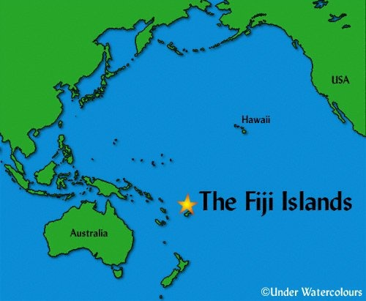
NATIONAL SECURITY
Fiji as a transit point for transatlantic / transnational drug smuggling into Australia & NZ.

Slide 5
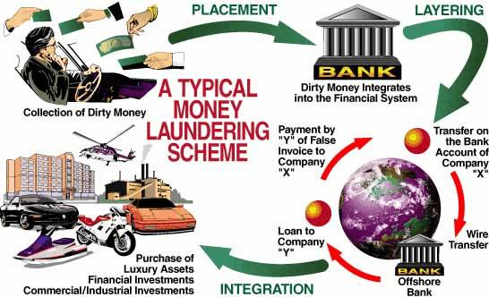
NATIONAL SECURITY
ii. Money Laundering & Terrorist Financing
A National Risk Assessment was conducted to identify Fiji’s risks and vulnerabilities

Slide 6
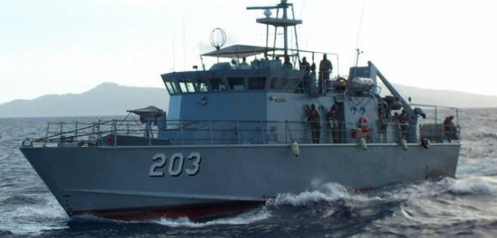
NATIONAL SECURITY
iii. Monitoring and patrolling of our EEZ / Policing the Pillage of Fisheries resources from our EEZ
Fiji has an exclusive economic zone (EEZ) of about 1,290,000 km2, while having a land area of about 18,333 km2

Slide 7
NATIONAL SECURITY
iv. Political and Economic uncertainty & Skilled Migration
Migration levels;
1987: 2,460 – 5,000 people
1992: 4,600 people
2001: 6,300 people
1987 – 2001: 75,800
Indo-Fijians: 89%
Fijians & other races: 11%

Slide 8
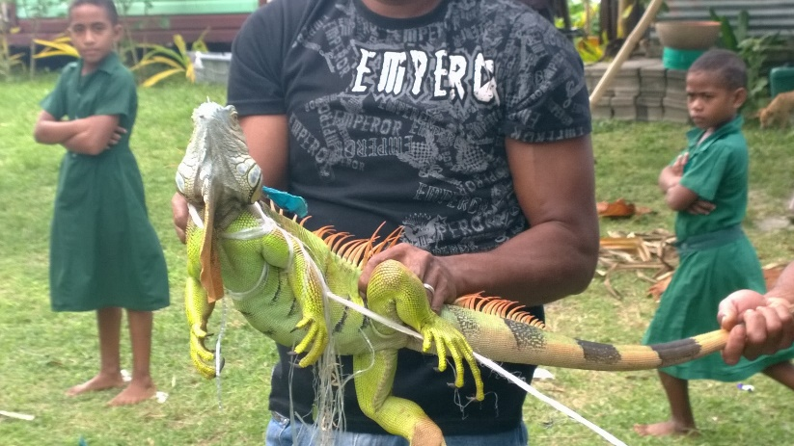
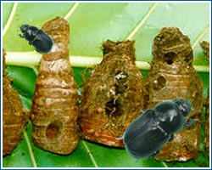
BIOSECURITY
Biosecurity is one of the most important national security considerations
The American Iguana threat
Asian subterranean termites
Fruit flies
Taro beetle

Slide 9
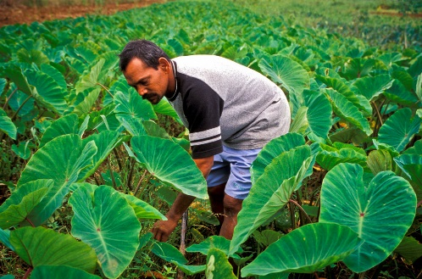
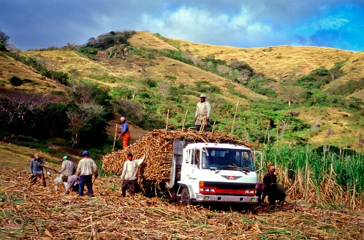
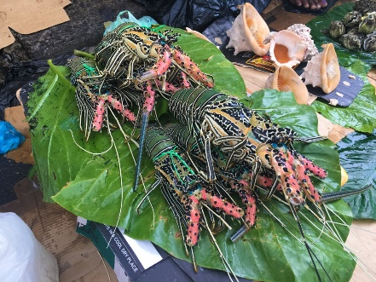
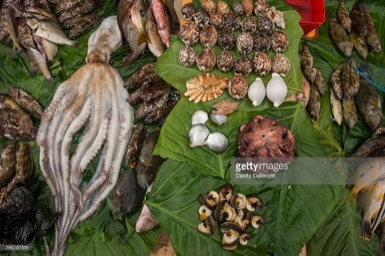
FOOD SECURITY
The concept of ‘food security’ in the Fijian context is defined as the ability to produce safe, healthy, affordable food for all Fijians at all times

Slide 10
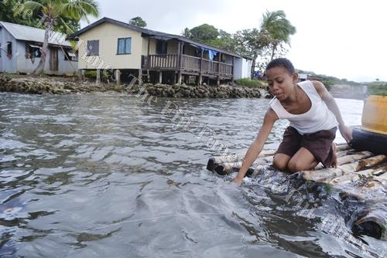
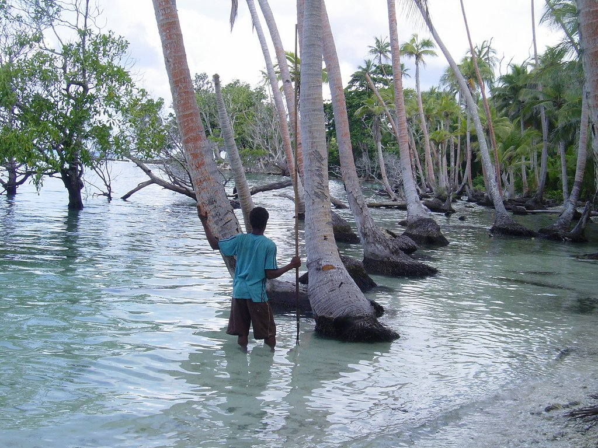
CLIMATE CHANGE
As a Pacific Island nation, Climate Change is an issue that I close to our heart.

Slide 11
CONCLUSION
Security is a major concern for Fiji
Food Security + Biosecurity = National security

Slide 12
VINAKA

