Slide 1


Slide 2

Population growth rate 1966 to 2000:
2.4% to 2.6% per year
Doubling time 30 years
12
6
2
1966
2000
2030

Slide 3
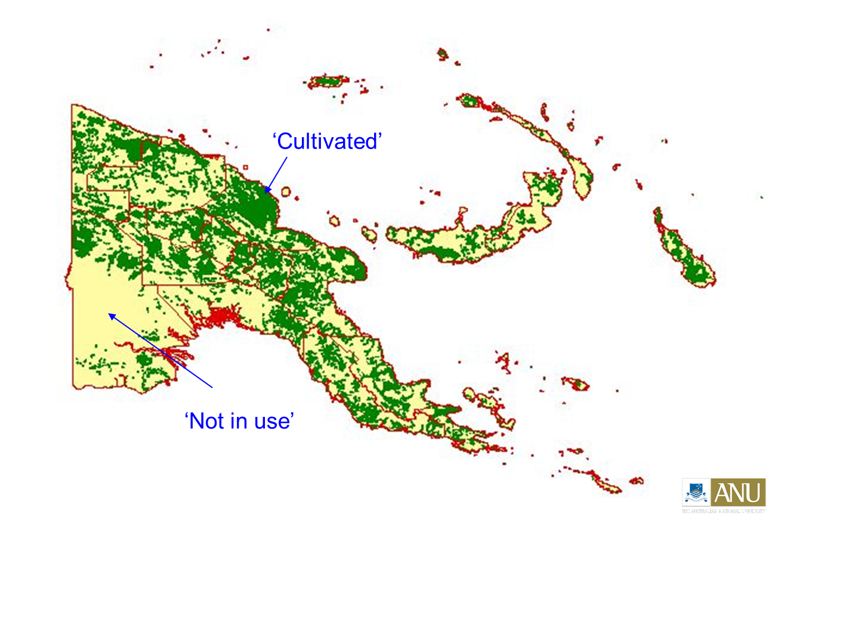

Slide 5
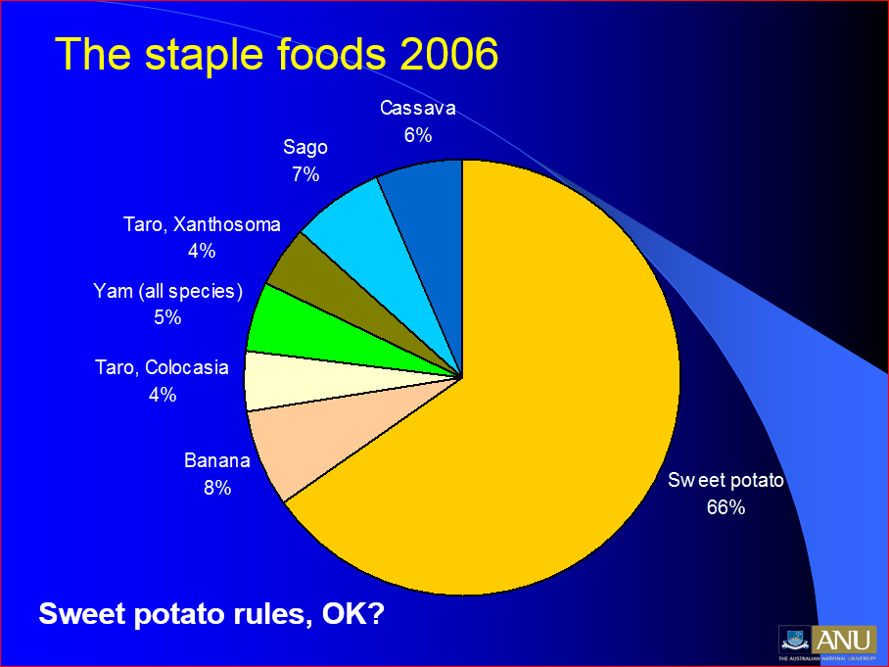

Slide 6
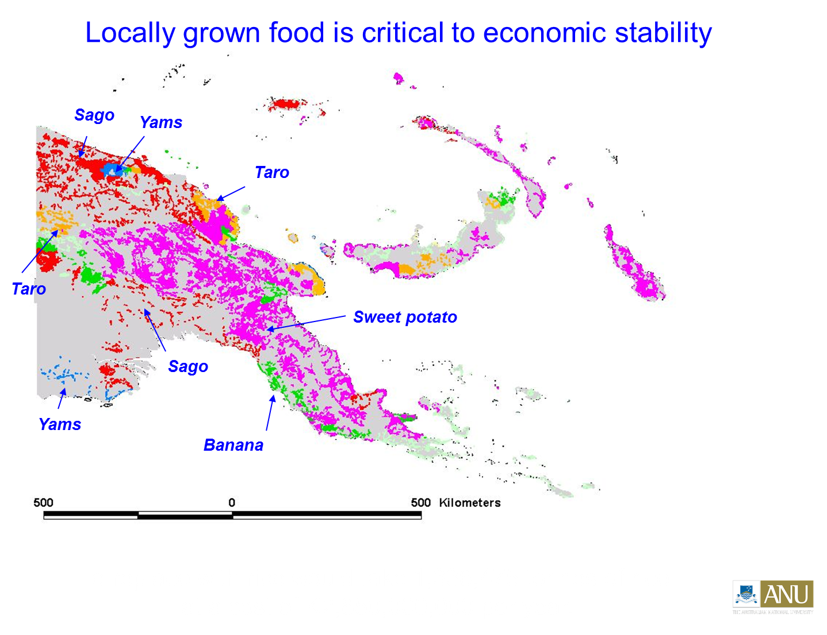

Slide 7
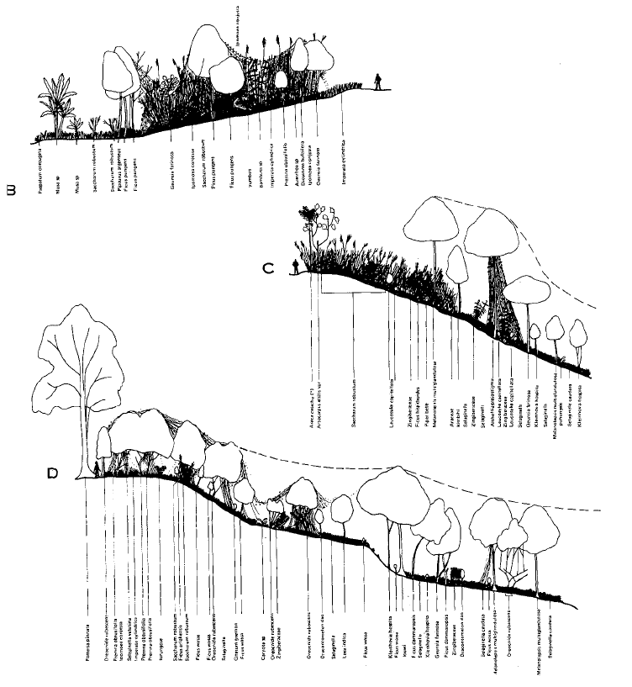
Fallow Successions
The regrowth in a fallow plot is influenced by rainfall, soils and the surrounding vegetation.
A series of plant communities succeed one another on the fallow plot, each community providing the environmental conditions for the next.
A typical 30 year succession is:
(1-2 years) short grasses and weeds;
(5 years) tall cane grasses;
(15 years) softwood trees and scrub;
(20-30 years) hardwood trees.
Bryant Allen 2015

Slide 8
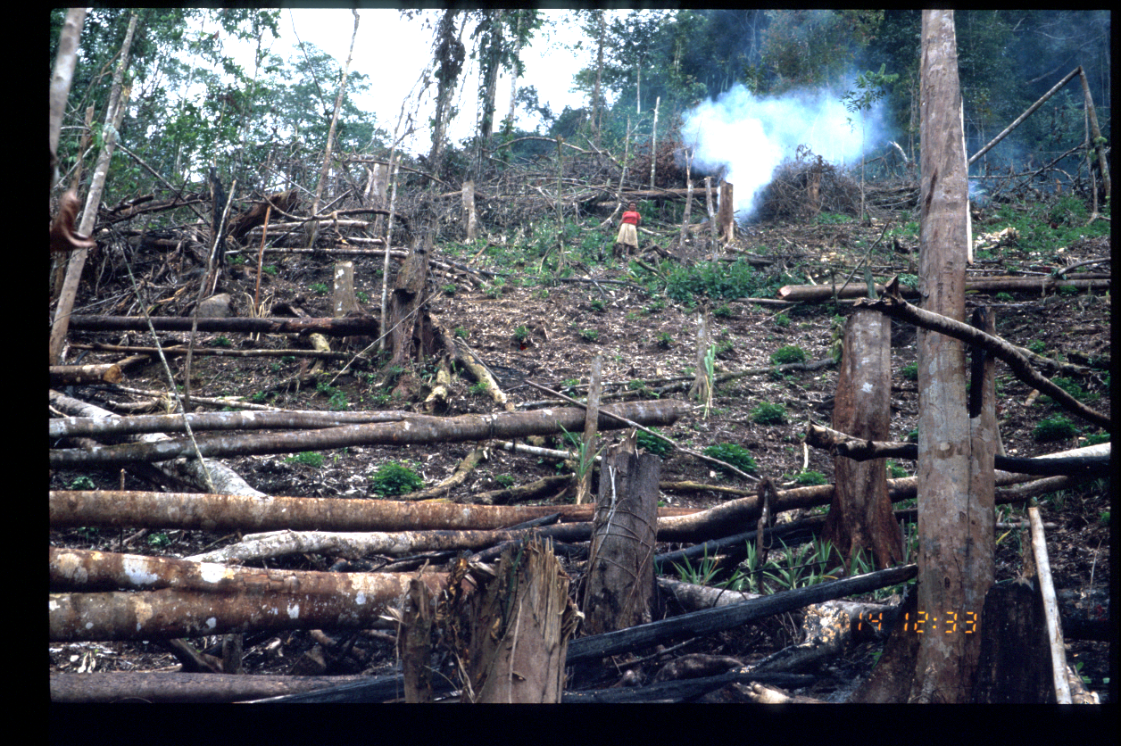
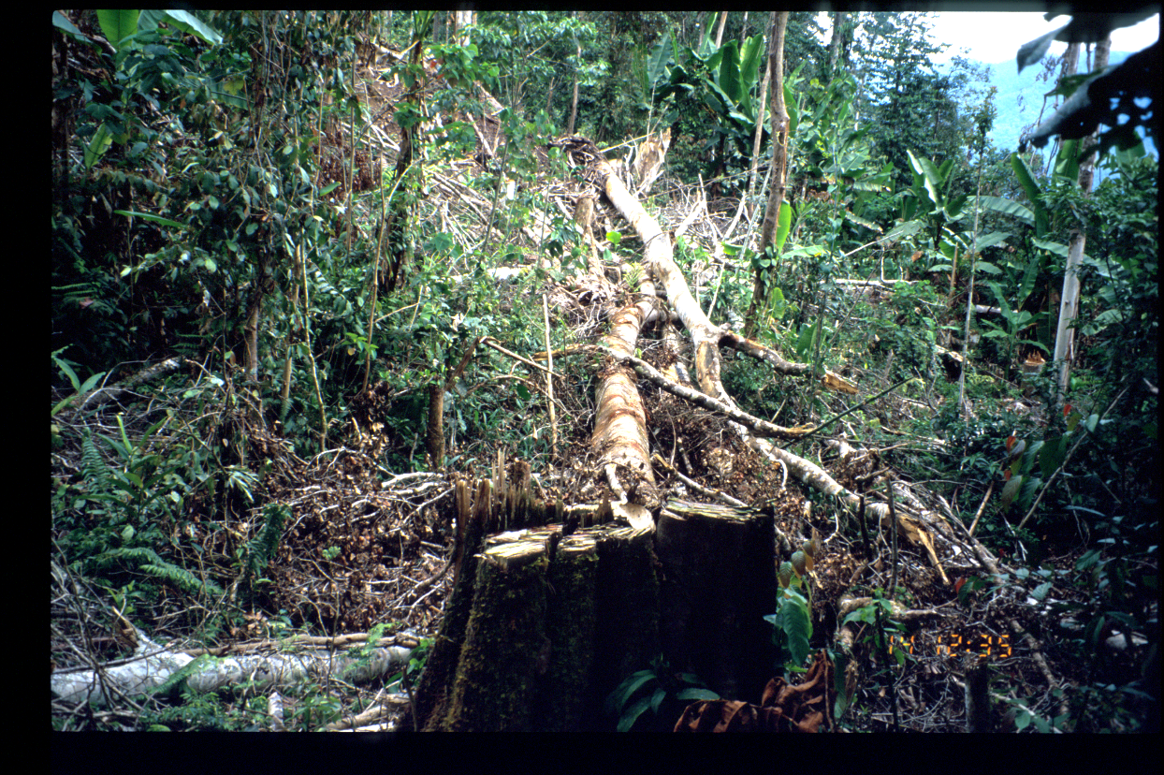
Forest fallow systems in Upper Sepik Valley. Large trees are felled, debris is burned and one planting is made before a long fallow of 25-30 years.

Slide 9
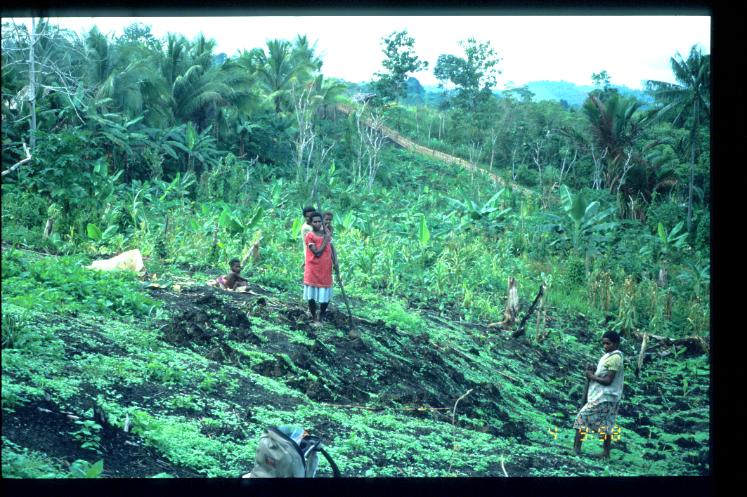
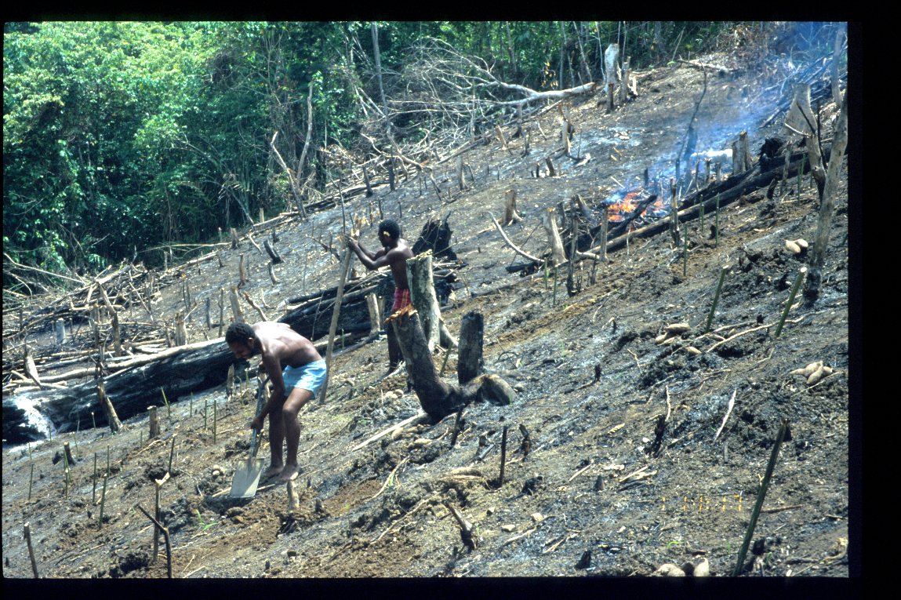
Bush fallowing inland of Madang
Low trees and tall grasses are cleared.
The land is not tilled.
Two crops are planted before a 15 year fallow.

Slide 10
Grass fallows near Yangoru, East Sepik.
A strong dry season has resulted in the loss of forest and innovation in agricultural techniques. The fallow period is around 15 years and two plantings of yams and taro are made before the plot is fallowed.

Slide 11
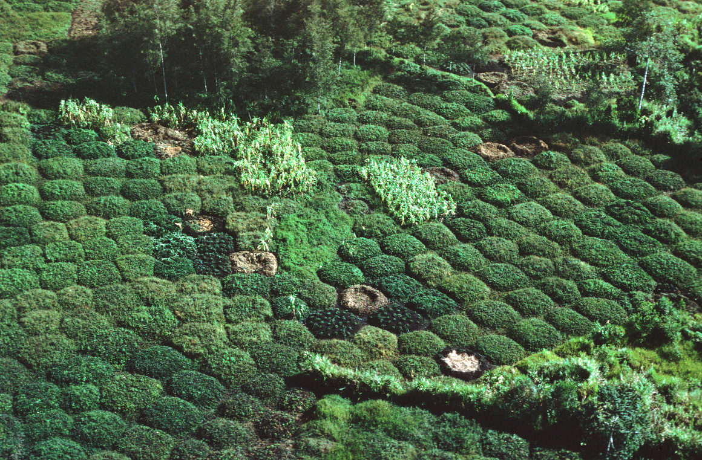
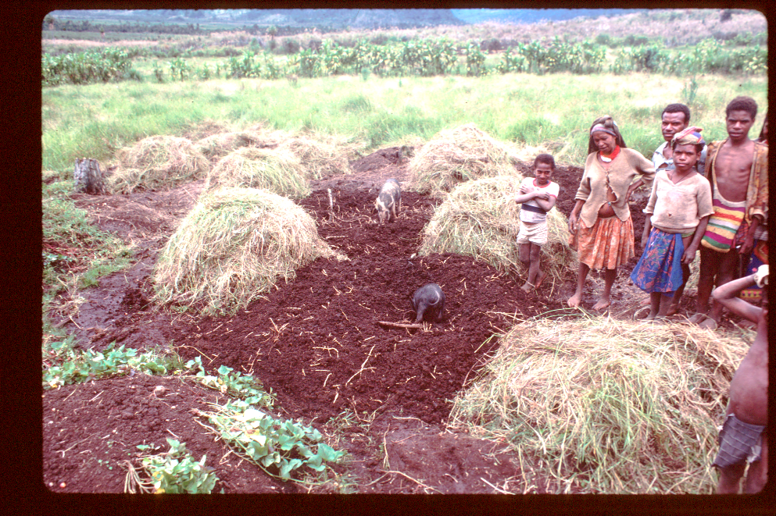
Short fallow systems in Enga Province.
Fallows are short, between 2 and 3 months long. Cultivation periods up to 20 years.
Land is completely tilled with shovels and formed into mounds; grasses, weeds and old vines are buried in the soils as green manure (compost).

