Slide 1
Fisheries for food security in the Pacific Islands
Brooke Campbell, ANCORS/UOW
Security: Food Security, Biosecurity and National Security in the Melanesian Arc
22 February 2017
AIIA Conference Centre, Canberra

Slide 2
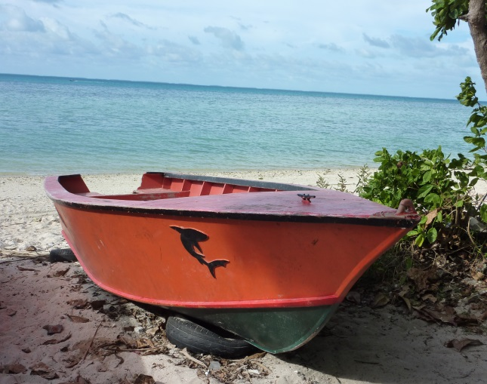
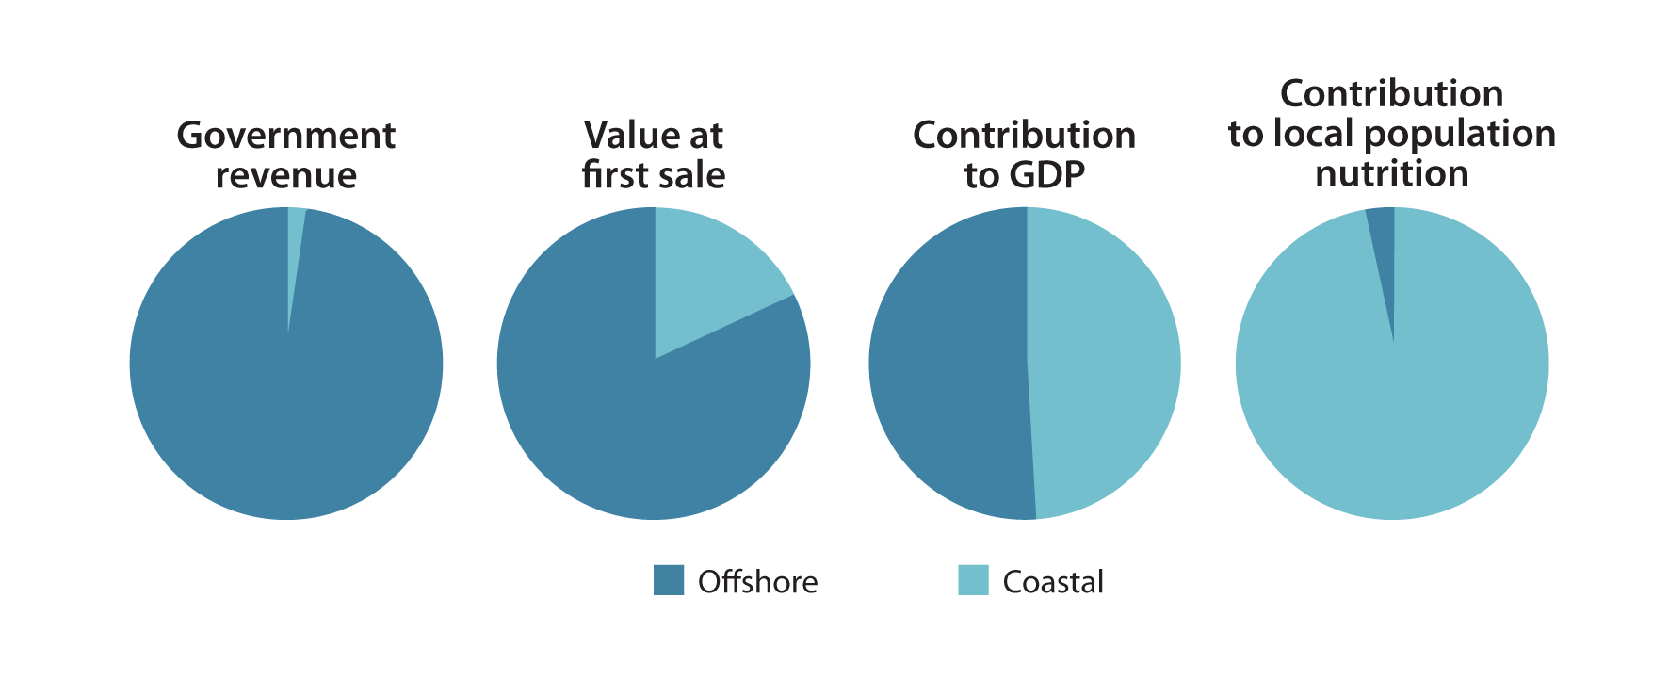
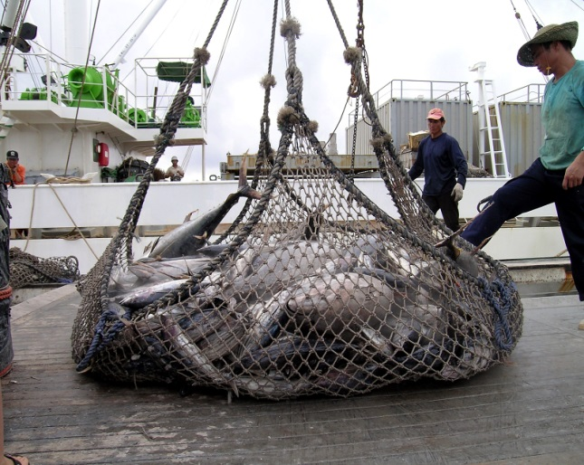
Overview of Pacific fisheries
60% of world’s tuna comes from WCPO region
Coastal fisheries provide 49% of total fisheries share of GDP.
Fisheries provide 50-90% of animal protein for coastal communities
Regional studies: 75% countries may not meet estimated food protein security needs by 2030
Source: Pacific Community (SPC)

Slide 3
Pacific food fish security: meeting the challenges
Availability – Where will fish supply come from?
Domestic? Imports/Substitutions? Oceanic? Aquaculture?
Access – How will all people access supply?
E.g., rural, inland, urban distribution systems, household income, marginalised groups
Utilisation – How will people use fish once they get it?
E.g., nutritional status
Stability – What policies and management practices will secure sustainable fish supply through time?
E.g., reduce/manage vulnerability to ecological, socio-political, economic factors
Solutions must be integrated and context-dependant

Slide 4
Thank you

