Slide 1
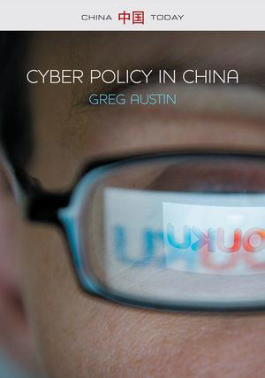
DIPLOMACY IN CHINA’S RACE FOR
CYBER-ENABLED POWER
2014
Polity (UK)
Wiley (USA)

Slide 2
CHINA’S GOAL
To become an advanced information society …
… the widespread exploitation in all sectors of the economy, science, education, culture and society of advanced technologies in information processing, based on a pervasive, highly modern communications infrastructure
= informatization

Slide 3
CHINA’S INFO TECH ACHIEVEMENTS
manufacturing: Lenovo “biggest” PC manufacturer in the world (2013)
social: more netizens than any other country
scientific: first teleportation of quantum properties between remote particles (2012)
engineering: IPv6 leadership role, fastest supercomputers
security: “Biggest” surveillance system in human history (in terms of manpower)
foreign intelligence: cyber espionage

Slide 4
NET ASSESSMENT:
WORLD ECONOMIC FORUM
Network Readiness Index of the annual Global Information Technology Report: China’s ranking
2002-03: 64th (Sachs et al)
2011: 36th
2012: 51st
2013: 58th
2014: 62st
  …. among 148 countries

Slide 5
SHANGHAI ACADEMY SOC SCI
SMART CITIES RANKINGS NOV 2014
London
Seoul
Hong Kong
Singapore
Toronto
New York
Chicago
Berlin
Sydney
Paris
Tokyo
Los Angeles
Buenos Aires
Dubai
Moscow
Shanghai
Beijing
Mumbai
Rio de Janeiro
Cairo

Slide 6
LEADERSHIP VIEWS
China’s leaders accept the broad thrust of these assessments: China is (a) lagging and (b) slipping off the pace
The book is not primarily about what happens in cyberspace
It is a book about China’s leadership and their view of the country’s “cyber-enabled power” – (a) how advanced information technology enables shifts in power (politics, economics, strategic/diplomatic) (b) what China has to do to be competitive in these “new” power stakes

Slide 7
CYBER-ENABLED POWER:
REFERENCE CONCEPTS AND DATES
Machlup 1962: knowledge economy
Information economy
Post-industrial society (Bell 1973) information-led
Masuda 1980: “computopia”, information utilities, redefinition of privacy: information society
Internet revolution: information superhighway
(1980-1995)
World Summit on Information Society 2002-03

Slide 8
INFORMATION SOCIETY:
HOW TRANSFORMATIONAL?
Transformational, and radically so; Castells 2012: politics “forever transformed”
Value-based, people-oriented -- not merely technologies (WSIS 2002-3, CAS Roadmap 2011)
Floridi: sufficiently different to reassess
Frost: inevitable ethical contest
the Chinese leaders are in a “dialogue” with the world on values for the info society … no end … CCP does not win

Slide 9
CHINA TIME LINE
1983 Toffler and electronics industry target
1993 Leaders decide for information economy
1995 public access to internet, USITO
1999 USA uses cyber operations against Belgrade
2000 information society decision & take-off
2001 Small Leading Group moves to Premier
2003 war under informatization; “Titan Rain”
2006 National Informatization Plan 2006-2020
2010 internet white paper
2011 CAS Roadmap for Information Technology
2014 Xi proclaims “cyber power” ambition

Slide 10
IDEAL VALUES
FOR AN INFORMATION SOCIETY
National information ecosystem
freedom of information exchange
protection of information exchange
trusted information
Innovative information economy
transformation intent
innovation system
innovator class
Global information ecosystem
strategic stability: for trade, invest^{t}, & security
bridging military divides
Interdependent informatized security

Slide 11
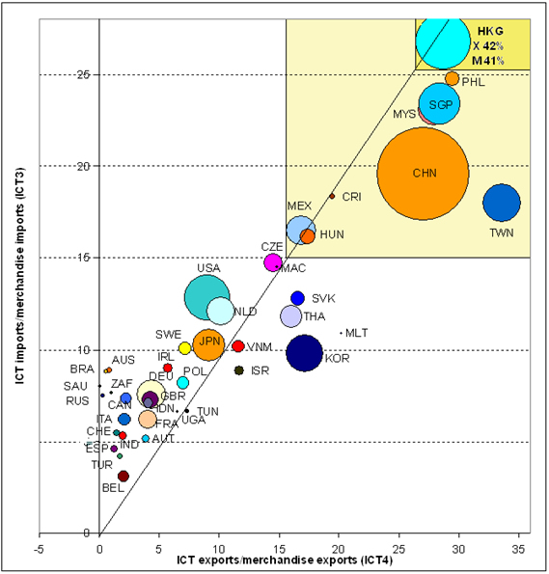
ICT SHARE, MERCHANDISE TRADE, 2012
About 2/3 of China’s ICT production is from foreign-invested or foreign-owned factories

Slide 12
SECURITY IN GLOBAL INFO-SPHERE: IDEAL VALUES
Strategic stability (#1)
No military divides (#2)
Interdependent informatized security (#3)

Slide 13
TIMELINE OF CHINA’S CYBER MILITARY DEVELOPMENT
2001 PLA joins Informatization Leading Group
2003 CMC Decision at doctrinal level; two stages 2020 & 2050
2006 Training regs approved
2007 Anti-satellite weapon test
2011 Changes in GSD comms structures
2014 “Cyber Power”, Xi takes control

Slide 14
#1 STRATEGIC STABILITY
strong commitment in principle to a stable world order … to allow ICT development
want an adjustment of the balance of power more in their favour
committed to positioning the country for long-term cyber military power
concerned about U.S. capability for pre-emption (cyber in nuclear C4I)
an aggressive actor in cyber espionage (like other major powers)
a conflict in these values and need for reassurance on all sides.

Slide 15
#2 BRIDGING DIVIDES
a deepening commitment to peaceful integration with Taiwan because this strategy is working
China has replaced the United States as Taiwan’s main economic partner
the pay-offs for China in Taiwan policy have been spectacular
Yet its adversarial view of the United States had deepened considerably.

Slide 16
#3 INTERDEPENDENT
INFORMATIZED SECURITY
committed in principle and practice to cooperative norms in economic and technological aspects of the global information economy
strengthened its commitment to joint problem solving in non-military domains
unable so far to bridge its formidable differences with the United States and like-minded countries over internet governance.

Slide 17
LOOKING AHEAD:
INTERNATIONAL SECURITY
timetable of 2050 for full informatization of the armed forces should be attainable
considerable successes in cyber espionage, but so too its potential adversaries
unlikely to make an appreciable dint in the ‘information superiority’ of the US global alliance system
China’s race for capability will take more account of diplomatic costs because China needs a globalized economy.

Slide 18
CONCLUSIONS IN THE BOOK
China's censorship policies and its “closed” education system have constrained its ambitions to become an advanced technology country
China's leaders are deeply concerned about the difficulty of building a high-performing national innovation system
China has proven itself incapable of resisting the powerful transformation effects of the information age
The leaders now want more, not less.

Slide 19
WHAT CAN WE LEARN
China and the USA are both subject to an information revolution that is transformational and NOT defined by the policy preferences of either. IT underpins all advanced science
China’s cyber power will remain heavily dependent on private actors and governments in the United States, Japan, and the European Union (the greatest “lawful” transfer of wealth in human history … since at least 1979)
“Knowledge has no flag”… except in the narrow area of national security, and even there allegiances have been blurred irrevocably by the information revolution
For Australia: China’s cooperative impulses far outweigh their combative impulses, but they are in a competitive mode

Slide 20
THANK YOU
Cyber Policy in China, Cambridge: Polity 2014

Slide 21
FOOTNOTE: COMMERCIAL ESPIONAGE
United States has launched a diplomatic strategy premised on the distinction between national security intelligence and economic intelligence collected by China for the benefit of China’s civil sector firms
In the public record to date, the U.S. administration has not even gone close to proving charges that it is Chinese government policy to direct its intelligence officials to hand over foreign corporate secrets to its civil sector firms in order to sabotage U.S. competitiveness either at the firm level (see Westinghouse nuclear case) or national level
The United States may have such evidence but there is considerable room to believe that it does not (see 2013 White House paper, NCIX reports, and the indictments)

