Slide 1
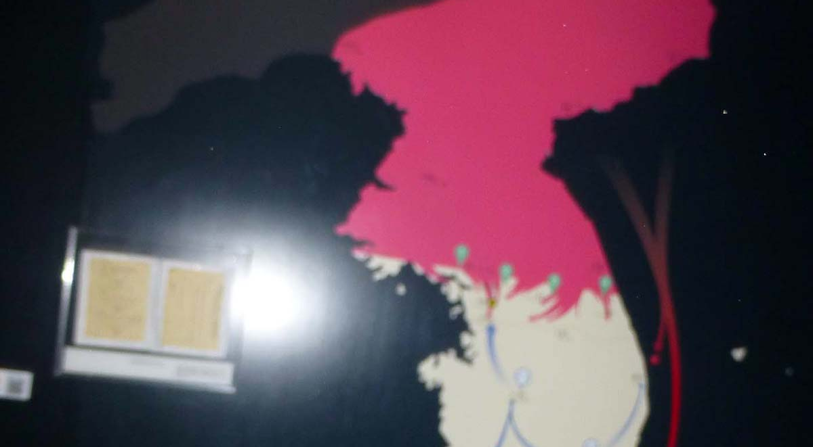
War,Peace, or what?
Colin Chapman on “The “Geopolitics of Korean Unification”

Slide 2
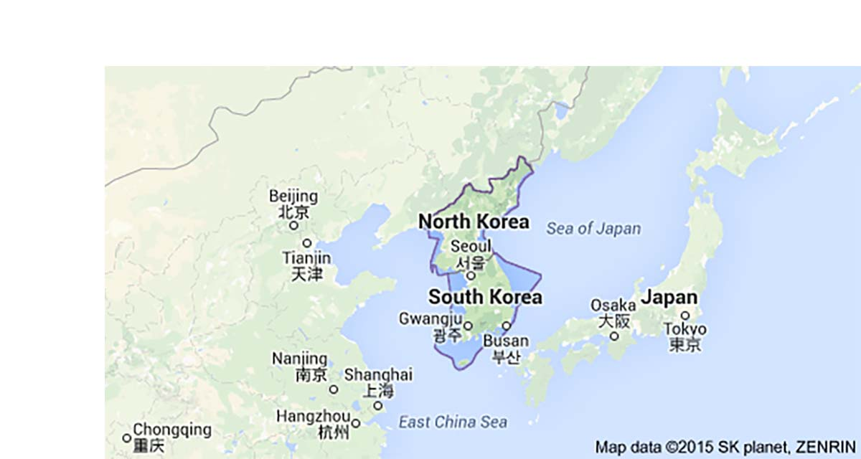
Strategic position
Korea Central pivot in North Asia

Slide 3
Australia-South Korea
Both have US as strategic partner - and China as main economic partner
Both middle income nations and members of the G20
Free trade agreement as one of a troika
concluded by Andrew Robb last year.
Both slid below 20 in global competitiveness.

Slide 4
The differences
South Korea has the enemy at the gate. Less than 60km from Seoul, one of the world’s most densely populated conurbations.
South Korea is still at war.
Double our population with half in one city.
Highly industrialised.
World’s top shipbuilder.

Slide 5
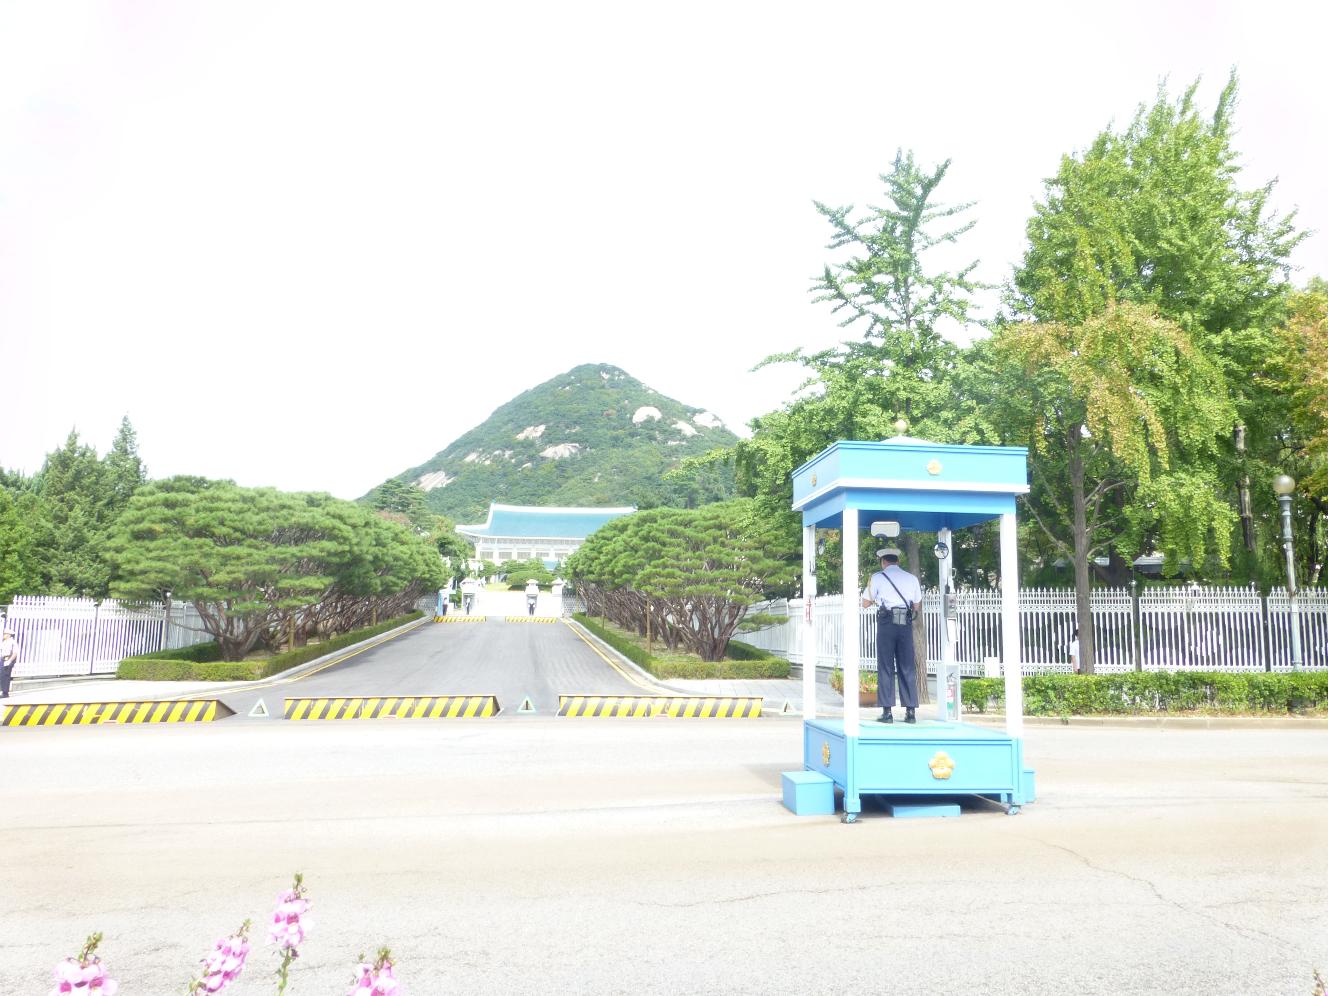
Presidential palace

Slide 6
Economy under pressure
Exports rose 1% last year, but…
Japan’s tumbling yen(down 50%) has made life very tough for Korean industry, which has held on only by good quality and stable prices.
But industry is under huge pressure..wage freeze at Samsung, the odd strike in Hyundai. Hyundai expanding overseas factories. One third of households have suffered a real decline in wages.
Business wants a deal with North Korea so it can access cheap labor, and have access to a bigger market.

Slide 7
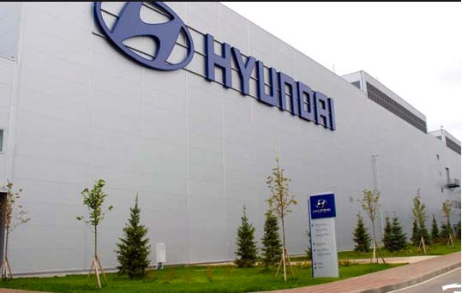
Hyundai St Petersburg

Slide 8
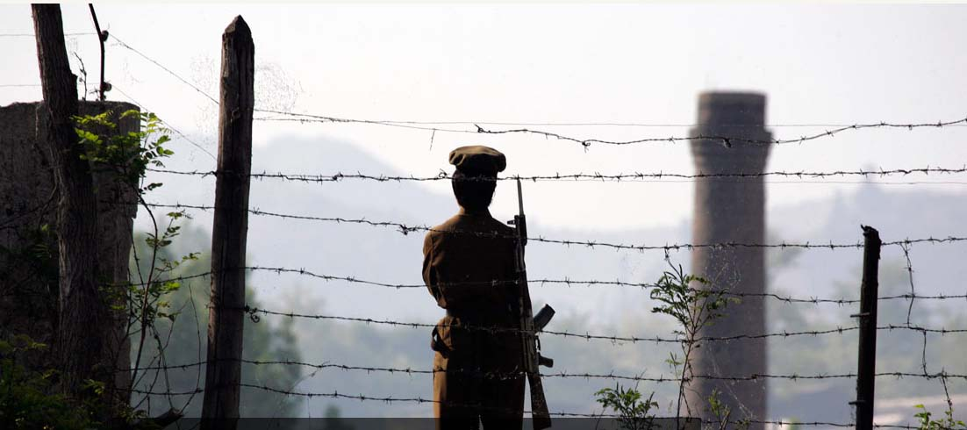
The worry

Slide 9
What’s out there?

Slide 10
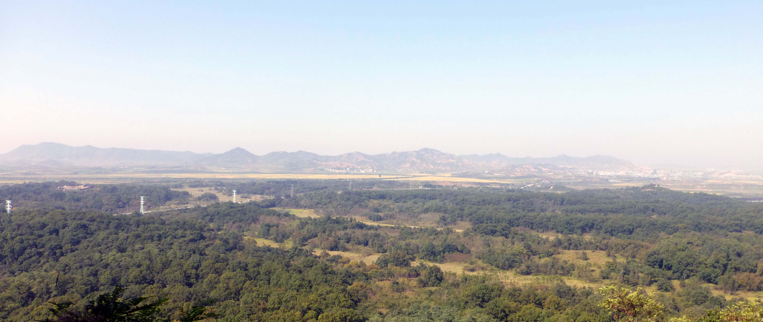
The view from the DMZ

Slide 11
Threat from the North
Between 4 and 10 nuclear devices.
Hundreds of intermediate & short range missiles.
Active uranium enrichment programs.
Only 25m people, but 4th largest land army. 2x SK’s with half the population. 28,500 US soldiers in harm’s way.
UN Commission says North has committed crimes against humanity, with 100,000 political prisoners

Slide 12
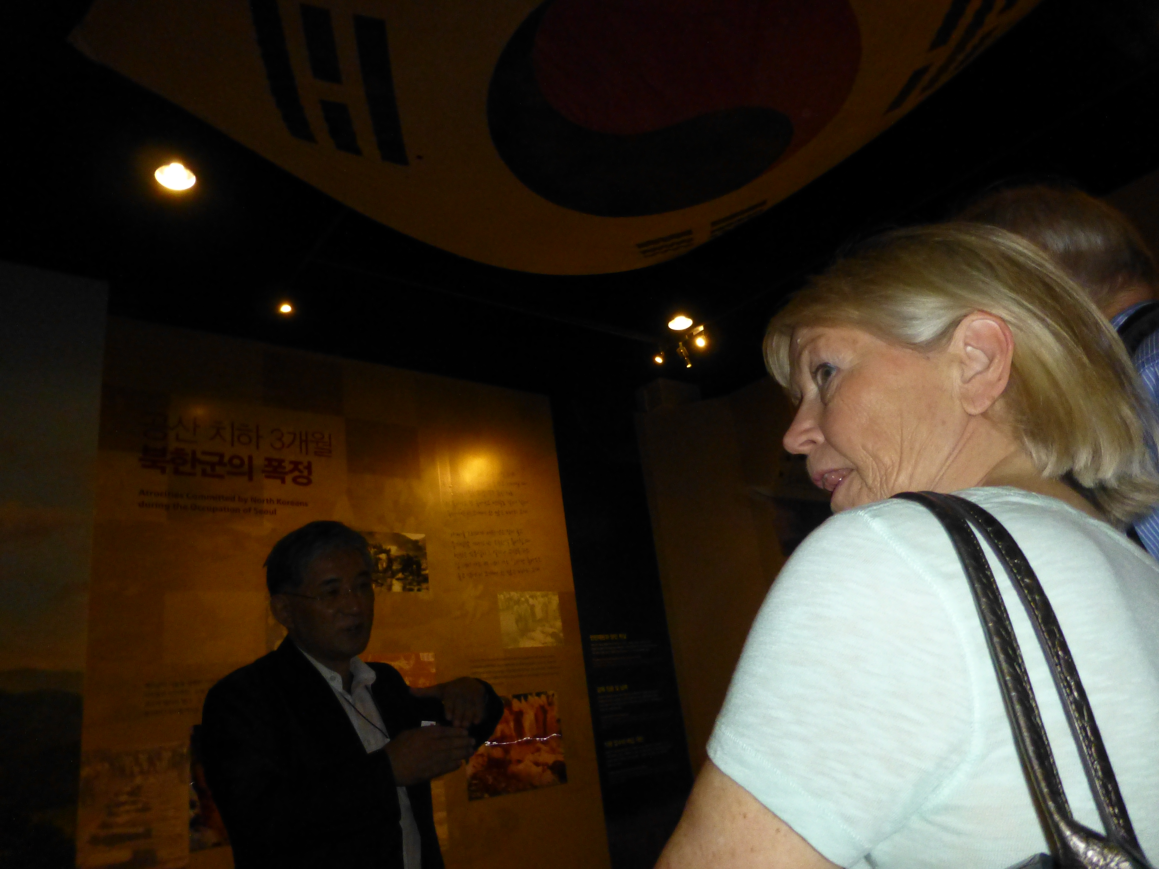

Slide 13
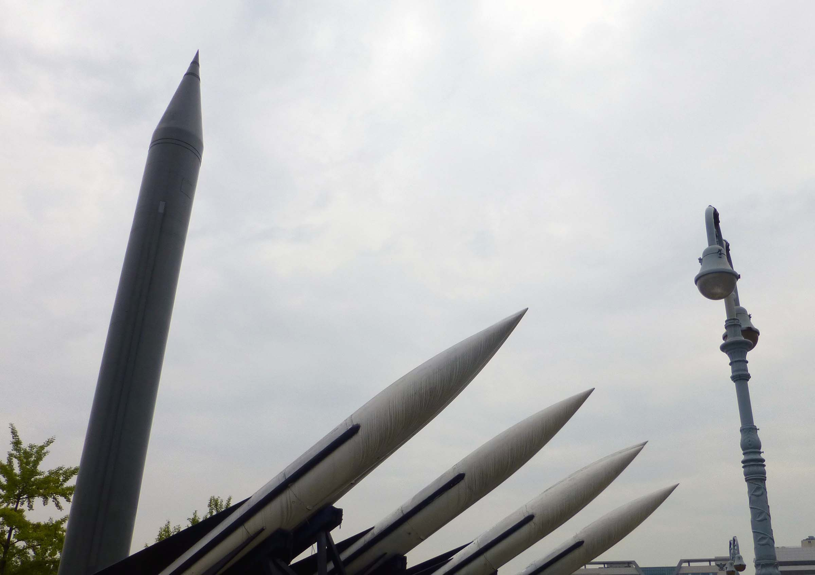
The winds of war
The winds of war

Slide 14
Reunification Scenarios
The North could collapse - like East Germany
Neither war nor peace - the status quo
Reconciliation - a negotiated settlement
Improved relations - normalization

Slide 15
Scenario risk assessment
Collapse
Refugees pour across the border down to Seoul
or across to China. This puts huge strains on
South Korean economy and on an already overcrowded city. Likely to lead to instability and guerrilla war. China does not want any more refugees than those it’s already getting.
Not going to happen soon. Chance = 25%

Slide 16
Scenario risk assessment
Negotiated settlement
Any negotiation leaves the Kim dynasty in
power-sharing agreement. Unacceptable to
most parties. Therefore it will not happen.
Chance = >5%

Slide 17
Scenario risk assessment
Status Quo
Continuing tension, involving US and Seoul
in huge cost.
Unpredictable outcomes, with high chance of either side making a mistake and unleashing Armageddon.
North Korea gets poorer – and potentially more dangerous – while uncertainty deters investment in South.
Chance = 75%

Slide 18
Where involved parties stand
The United States tends to favour – or hope for - the collapse of the North, because it ends costly deployment and reduces risk.
Only solution to automatically end sanctions
>$20 billion in increased merchandise trade
Restraint on US public investment

Slide 19
Where involved parties stand
Russia is violently opposed to any South Korea
takeover of the North. Short border on the Tumen
river heavily patrolled. Putin would see North
Korea as the Ukraine of the East.
“Our reaction would be much tougher than
Iraq or Libya”
Negotiated settlement in stages - with Korea a
neutral, non-aligned country.

Slide 20
Where involved parties stand
Japan favours a ‘peaceful, market-oriented
transition’, but warns that unless there is
huge investment in the North there will be
a wave of migration causing social and
political problems.
Japan believes a new ‘Super Korea” will be a major threat to Japan, but hopes to benefit in the long run.

Slide 21
Where involved parties stand
China the big winner of reunification, achieving its aim of a North Asia Free Trade Zone covering economies,currencies and standards. China-Japan-Korea FTA a first step.
BUT
they don’t want US forces on their borders, and have long memories of WW II and Japan.Starting point is to end the isolation of North Korea - that could lead to the “jackpot”

Slide 22
Presenter: Colin Chapman
©Colinchapman 2014

Slide 23
Solution?
Hard to see one. Only workable one is likely to be a small step approach which is currently being tried, supported by US and China. But as long as Kim retains his nuclear ambitions - his only negotiating point - it’s hard to see much progress in the short term

